Slide 1

Explainable AI(XAI) - AN OVERVIEW
CS59000-BB
Trevor Bonjour
tbonjour@purdue.edu

Slide 2
What will we cover today?
What do we mean by interpretability?
Motivation
Interpretable Models
Model Agnostic Methods
Explainable Reinforcement Learning
Notes:
Today I’ll give a high-level overview of explainable AI.
I’ll start by defining what we mean by interpretability and why it matters.
Then I’ll cover interpretable models in supervised learning.
Next, I’ll move to model-agnostic explanation methods.
Finally, I’ll discuss explainability in reinforcement learning.

Slide 3
What
IS INTERPRETABILITY?
Interpretability is the degree to which a human can understand the cause of a decision.
Notes:
A decision could be a prediction, a recommendation, or any action that is produced
The higher the interpretability of a machine learning model, the easier it is for someone to comprehend why certain decisions or predictions have been made.
A model is better interpretable than another model if its decisions are easier for a human to comprehend than decisions from the other model.

Slide 4
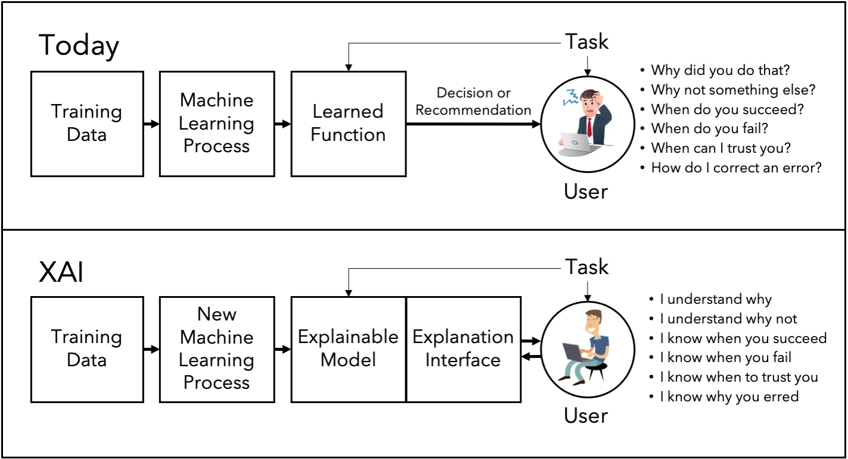
CONCEPT
Credit: DARPA, 2016
Notes:
Speaker notes for this picture (Today vs XAI):
The top diagram shows how machine learning systems typically work today.
Training data goes through a learning process and produces a learned function.
That function outputs a decision or recommendation to the user.
The problem is that the user only sees the output.
As a result, the user is left asking questions like:
Why did you do that?
Why not something else?
When does this system succeed or fail?
When can I trust it?
How do I fix an error?
The system provides no direct support for answering these questions.
The bottom diagram shows the goal of explainable AI.
We modify the learning process so the result is an explainable model, or we add an explanation layer.
An explanation interface sits between the model and the user.
This interface translates model behavior into human-understandable explanations.
The user can now understand why a decision was made.
They can also understand limitations, failure cases, and trust boundaries.
The key shift is from opaque decision delivery to interactive understanding.
XAI is not just about better models, but about better communication between models and humans.

Slide 5
Why
INTERPRETABILITY?
Decisions are critical in high-risk environments. Often machine learning algorithms are opaque.
Notes:
Most of the state of the art ML models – specially with the advent of deep learning models are “black boxes” – and hence they are often not deployed in a high-risk environment.
Interpretability is not required if the model has no significant impact.

Slide 6
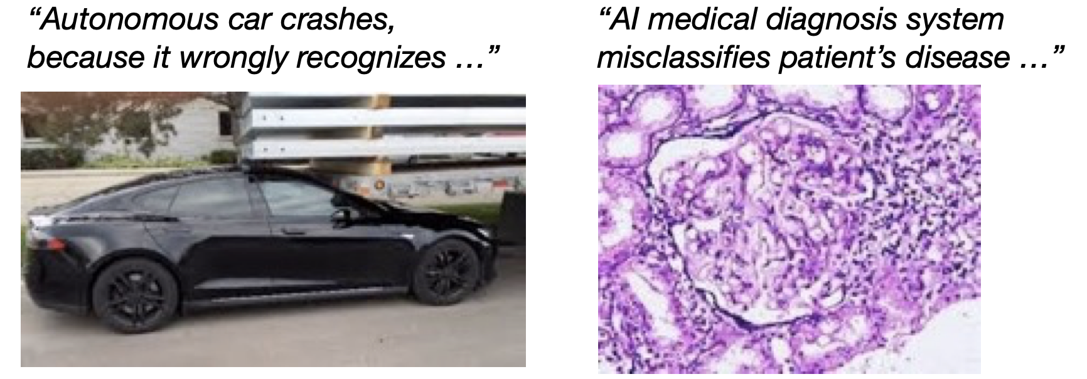
Why Interpretability?
Verify the model works as expected
  Wrong decisions can be costly and dangerous
Credit: Samek, Binder, Tutorial on Interpretable ML, MICCAI’18
Notes:
We need interpretability to Verify the model works as expected
Here we see how some wrong decisions can be costly and dangerous

Slide 7

Why Interpretability?
Learn new insights
  It was also so unusual that one of the commentators thought it was a mistake. Fan Hui explained, “It’s not a human move. I’ve never seen a human play this move.”
Credit: Samek, Binder, Tutorial on Interpretable ML, MICCAI’18
Notes:
Interpretability might be able to help us learn new insights. This is a quote from the Go champion Fan Hui after he lost to AlphaGo. Of we could understand why the ai system did what it did, we could learn new insights.

Slide 8
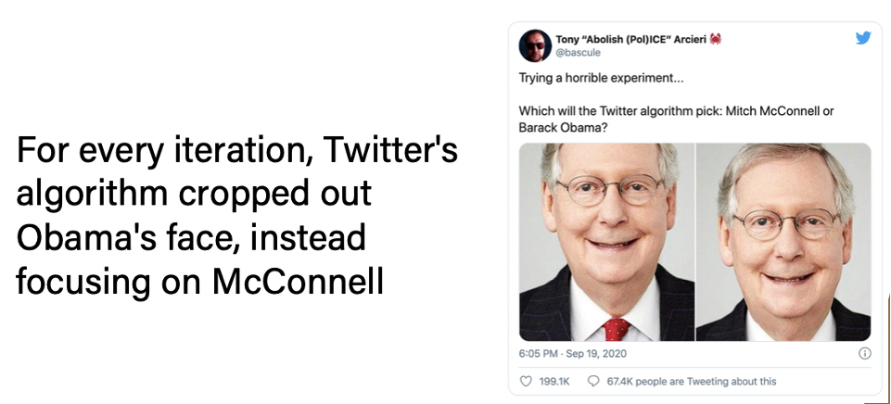
Why Interpretability?
Ensure Fairness
  Unbiased predictions, no discrimination against protected groups
Notes:
Interpretability also helps us ensure fairness – if the model is interpretable, it would be easier to make sure that it does not produce biased results. Here is an example from a twitter algorithm that was trained to pick a face for a post thumbnail automatically and it picked McConnel’s face and cropped out Obama’s face in every single iteration.

Slide 9


Why Interpretability?
Trust
  Easier to trust a system that explains its decisions compared to a black box.
This Photo by Unknown Author is licensed under CC BY-NC-ND
Notes:
If the models we are dealing with can be explained or interpreted, it would be easier to trust their output.

Slide 10

Why Interpretability?
Ensure Reliability
  Small changes in the input do not lead to large changes in the prediction.
Notes:
If we know how or why a model is deciding, we can ensure reliability and robustness – we can make sure that Small changes in the input do not lead to large changes in the prediction.

Slide 11
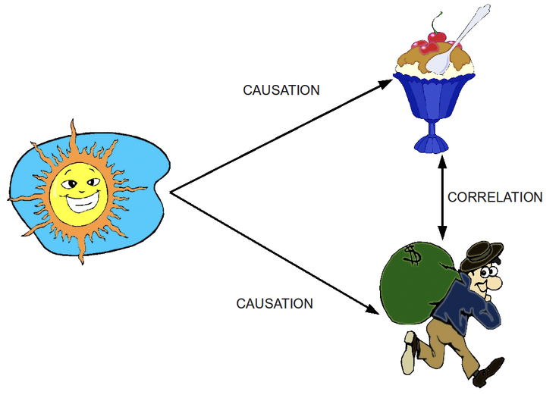
Why Interpretability?
Causality
  Check that only causal relationships are picked up.
Notes:
This figure illustrates the difference between correlation and causation.
The sun represents an underlying causal factor, such as hot weather.
Hot weather causes people to buy ice cream.
Hot weather also causes higher crime rates.
As a result, ice cream sales and crime are correlated.
However, ice cream sales do not cause crime.
The correlation exists because both are driven by the same causal factor.
Machine learning models are very good at picking up correlations like this.
Without interpretability, a model might incorrectly rely on correlated features.
Interpretability helps us detect when a model is using spurious correlations instead of causal relationships.
This is why understanding why a model makes decisions matters, not just what it predicts.
Correlation is easy to learn; causation is what we actually care about.

Slide 12

Why Interpretability?
Debug (Mis-)Predictions
  Why did the model (mis-)classify this as joy?
Top Label: ”joy”
Notes:
We could also debug mis-predictions and learn more why it mis-predcited a label that can help us make the model more robust.

Slide 13
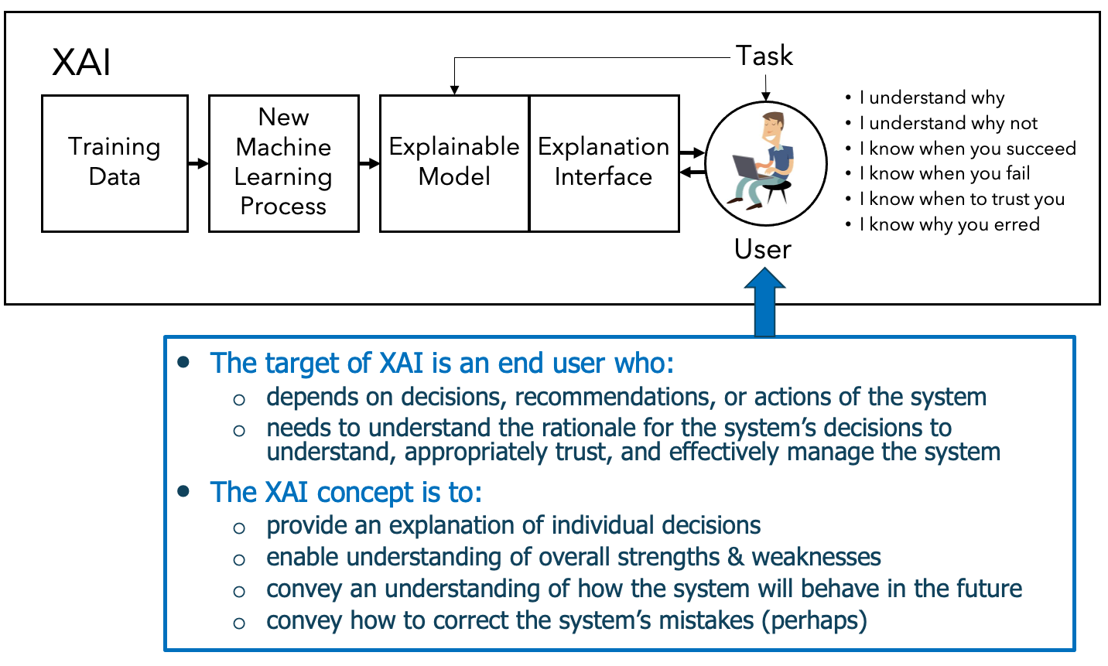
Need for Interpretability
Credit: DARPA, 2016
Notes:
This slide makes explicit who explainable AI is really for.
The target of XAI is the end user, not the model developer.
This is someone who depends on the system’s decisions, recommendations, or actions.
Because of that dependence, they need to understand the system’s rationale.
Understanding supports appropriate trust, not blind trust.
It also allows the user to manage and intervene in the system effectively.
The diagram at the top shows that XAI is more than just an explainable model.
It includes an explanation interface that mediates between the model and the user.
This interface allows the user to ask meaningful questions about the system’s behavior.
The core goals of XAI are fourfold.
First, to explain individual decisions.
Second, to help users understand the system’s overall strengths and weaknesses.
Third, to give users an intuition for how the system is likely to behave in the future.
And finally, in some cases, to indicate how system errors might be corrected.
XAI is about enabling informed use, not just producing explanations.

Slide 14
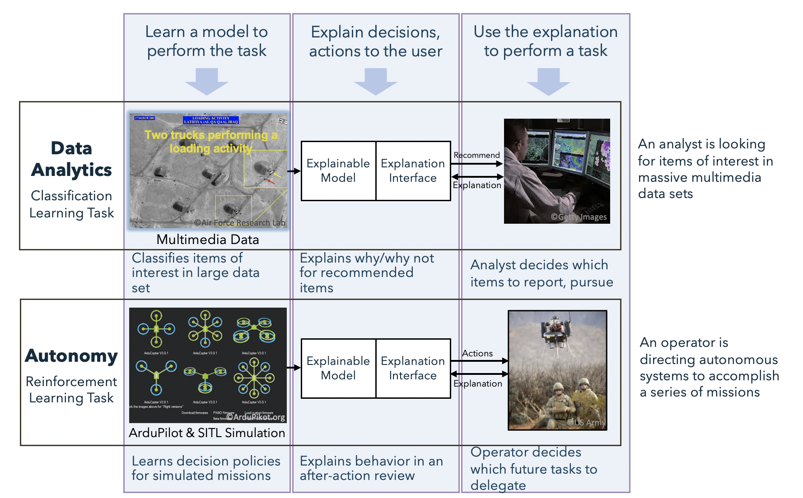
Problem Areas
Credit: DARPA, 2016
Notes:
This figure comes from DARPA’s original XAI program materials.
It highlights that explainable AI is needed across different classes of tasks, not just one setting.
In particular, DARPA emphasizes both data analytics tasks and autonomous decision-making tasks.
The top row illustrates a data analytics scenario, such as classification.
A model is trained to identify items of interest in large multimedia datasets.
An explainable model and explanation interface present recommendations to a human analyst.
Crucially, the system does not make the final decision.
The analyst uses both the prediction and the explanation to decide what to report or pursue.
The bottom row shows an autonomy scenario, based on reinforcement learning.
Here, the system learns decision policies through simulated missions.
Explanations are provided to a human operator, often after the fact.
The operator uses these explanations to understand behavior and decide which future tasks to delegate.
Again, the human remains in the loop.
Across both examples, the structure is the same.
An explainable model is paired with an explanation interface.
Explanations support human decision-making, not replace it.
In the next slides, I’ll first focus on interpretability in classification tasks.
After that, I’ll cover approaches for explainable reinforcement learning.
XAI is about supporting human judgment across both predictive and autonomous systems, not removing it.

Slide 15
Interpretability
in Classification Tasks

Slide 16
Interpretable Models
Linear/Logistic Regression
Decision Trees
Notes:
First lets talk about interpretable models – these models are considered interpretable by design.

Slide 17
Advantages/Disadvantages
Linear/Logistic Regression
  Predicts the target as a weighted sum of the feature inputs making the mechanism somewhat transparent.
  Widely used – high level of collective experience and expertise
  Guaranteed to find optimal weights(provided assumptions are met)
  Can only represent linear relationships (non-linearity must be hand-crafted)
  Often not that good regarding predictive performance
  Interpretation of weight unintuitive
Notes:
Mention the pros and cons.
Interpretation of weights unintuitive: coefficients reflect the effect of a feature conditional on all other features. With correlated inputs, a feature that is positively correlated with the outcome can receive a negative weight, because the model assigns it only the remaining variation after accounting for other correlated features.

Slide 18
Advantages/Disadvantages
Decision Trees
  Ideal for capturing interactions
  Has a natural visualization
  Creates good explanations
  Does not deal with linear relationships
  Slight changes in the input feature can have a big impact on the predicted outcome
  Unstable - few changes in the training dataset can create a completely different tree
  Decision trees are very interpretable -- as long as they are short
Notes:
List pros and cons…
Trees fail to deal with linear relationships. Any linear relationship between an input feature and the outcome has to be approximated by splits, creating a step function. This is not efficient.
Also trees are interpretable to an extent – if it was a huge tree – it would soon not be as intuitive to the human user.

Slide 19
Model Agnostic Methods
Permutation Feature Importance
Global Surrogate
Local Surrogate(LIME)
Shapley Values
Notes:
Now let’s talk about some Model Agnostic Methods that can be employed to make a model interpretable or explainable. We have …
Permutation Feature Importance
Global Surrogate
Local Surrogate(LIME)
Shapley Values

Slide 20
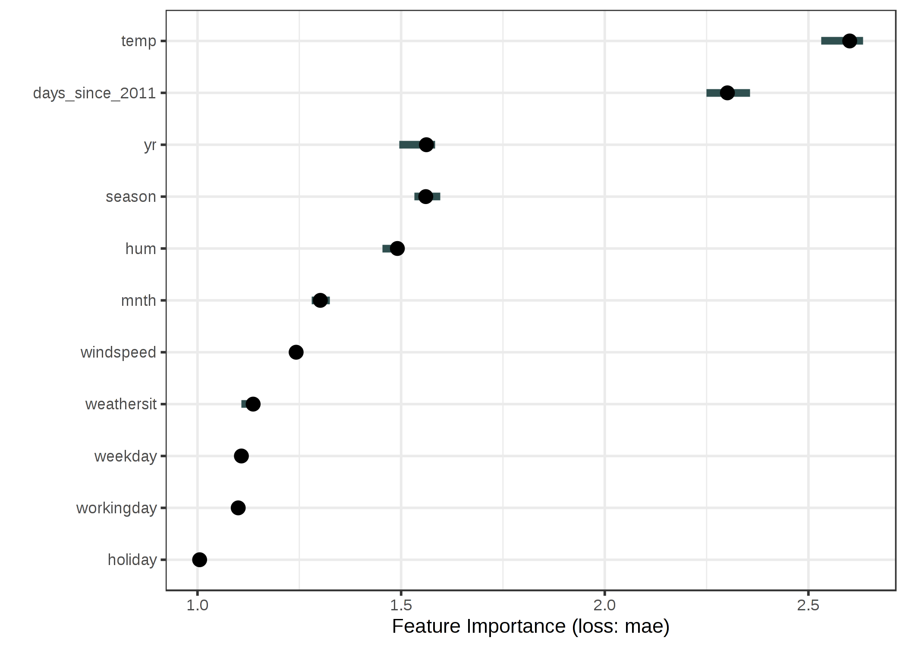
Permutation Feature Importance
Measure the importance of a feature by calculating the increase in the model's prediction error after permuting the feature.
  Introduced for Random Forests by Breiman (2001)
  Model agnostic method proposed by Fisher, Rudin, and Dominici (2018)
  Important Feature: If shuffling the values increases the error
  Unimportant Feature: If shuffling the values leaves the model error unchanged
Notes:
Permutation feature importance answers a simple question: how much does the model rely on this feature?
The idea is to randomly shuffle one feature while keeping everything else the same.
Shuffling breaks the relationship between that feature and the target.
We then measure how much the prediction error increases, here shown on the x-axis as MAE.
If the error increases a lot, the feature was important for the model.
If the error barely changes, the model was not really using that feature.
This method was first introduced by Breiman for Random Forests and later formalized as a model-agnostic approach.
The key benefit is that it works for any trained model, not just linear ones.
But it explains model dependence, not causality.

Slide 21

Global Surrogate
An interpretable model that is trained to approximate the predictions of a black box model.
True Labels
Input Features
Black Box
Predicted Labels
Surrogate
Interpretation
Notes:
A global surrogate is an interpretable model trained to approximate a more complex, black-box model.
Here, we are not interpreting the black-box model directly.
Instead, we train a second, interpretable model called a global surrogate.
The black-box model is trained as usual using the true labels.
Once trained, it produces predictions for many inputs.
Those predictions become the training targets for the surrogate model.
The surrogate learns to imitate the black box, not the ground truth.
Humans then interpret the surrogate to understand the black box’s overall behavior.
This gives a global, simplified view of how the black box operates.
The explanation depends on how well the surrogate approximates the black box, not on prediction accuracy.
We explain the model, not the data.

Slide 22
Local Surrogate
Train local surrogate models to explain individual predictions.
Concrete Implementation: Local interpretable model-agnostic explanations (LIME) by Ribeiro et al.(2016)
Perturbed Daataset
Black Box
Reweigh Samples
according to proximity
to instance of interest
Interpretable Model
Predicted Labels
Interpretation
- LIME uses exponential smoothing kernel for calculating proximity
- Good approximation of predictions locally, not globally
Notes:
Local Surrogate (LIME)
Local surrogate methods explain individual predictions, not the full model.
LIME is a concrete implementation of this idea.
We start with a specific instance we want to explain.
Around this instance, we generate a perturbed dataset by slightly modifying the input features.
These perturbed samples are passed through the black-box model to obtain predicted labels.
The samples are then reweighted based on how close they are to the original instance.
LIME uses an exponential smoothing kernel to compute this proximity.
Points closer to the instance receive much higher weight than distant points.
An interpretable model is trained on this weighted dataset.
The resulting explanation is a good approximation locally, but it does not describe the model’s global behavior.
Closing Line: LIME explains one prediction at a time, and only in the neighborhood of that prediction.

Slide 23
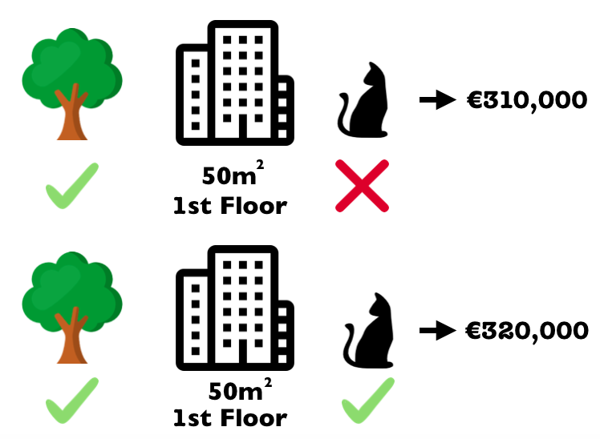
Shapley Values
Explain the prediction of an instance by computing the contribution of each feature to the prediction.
  A method from coalitional game theory (Shapley, 1953)
  Assign payouts to players(features) depending on their contribution to the total payout (prediction)
  SHAP (SHapley Additive exPlanations) by Lundberg and Lee (2017) connects it to LIME
Notes:
Shapley values come from game theory, where we want to fairly divide a total outcome among contributors.
In this analogy, each feature is a contributor and the house price prediction is the total outcome.
Imagine two houses that are identical in almost every way.
They are on the same floor, have the same size, and are both near a park.
The only difference is one feature: one house allows pets and the other does not.
The model predicts one house at $310,000 and the other at $320,000.
Since everything else is the same, the price difference must come from that one feature.
Shapley values formalize this idea by asking:
How much does a feature change the prediction when it is added to the model?
To be fair, this contribution is averaged over all possible orders in which features could be added.
This avoids giving too much credit to features just because of the order we consider them.
SHAP applies this idea to machine learning models.
It explains a prediction by breaking it into a baseline value plus contributions from each feature.
The contributions add up exactly to the model’s final prediction.
SHAP asks: if we add features one by one, how much does each one really contribute to the final prediction?

Slide 24
Interpretability
in Reinforcement Learning Tasks
Notes:
Reinforcement learning involves sequential decision-making.
Explanations must account for long-term behavior, not single predictions.
This makes interpretability more challenging.
Next let’s look at some examples of interpretability in RL tasks.

Slide 25
Explainable Reinforcement Learning
Programmatically Interpretable RL
Hierarchical Policies
Linear Model U-Trees
Notes:
I’ll discuss three approaches:
Programmatically Interpretable RL
Hierarchical policies
Linear Model U-Trees

Slide 26
PIRL
Programmatically Interpretable Reinforcement Learning framework by Verma et al. (2018)
  A policy is represented using a high-level, domain-specific, human-readable programming language.
  Mimics Deep Reinforcement Learning model (DRL)
  Neurally Directed Program Search(NDPS): Uses DRL to compute a policy which is used as a neural ‘oracle’ to direct the policy search for a policy that is as close as possible to the neural oracle.
Notes:
PIRL is a framework for making reinforcement learning policies interpretable by design.
Instead of representing a policy as a neural network, PIRL represents it as a human-readable program.
The program is written in a high-level, domain-specific language.
A high-performing deep reinforcement learning model is trained first.
This neural policy is not the explanation.
It acts as a neural oracle that demonstrates desired behavior.
PIRL uses Neurally Directed Program Search (NDPS).
NDPS searches for a programmatic policy that closely mimics the neural oracle.
The goal is to match behavior while gaining interpretability.
Some performance may be sacrificed in exchange for transparency.
There are important limitations to this approach.
The experiments only consider environments with symbolic inputs, not perceptual inputs like images.
Only deterministic policies are studied, not stochastic policies.
This limits where the method can be applied.
The design of the policy language is critical.
To make program search feasible, the language must be compact and canonical.
Policies are expressed using a functional language.
The language uses a small set of side-effect-free combinators.
This simplifies search, comparison, and reasoning over policies.
CLOSING LINE: In PIRL, interpretability comes from the structure of the policy program itself.

Slide 27
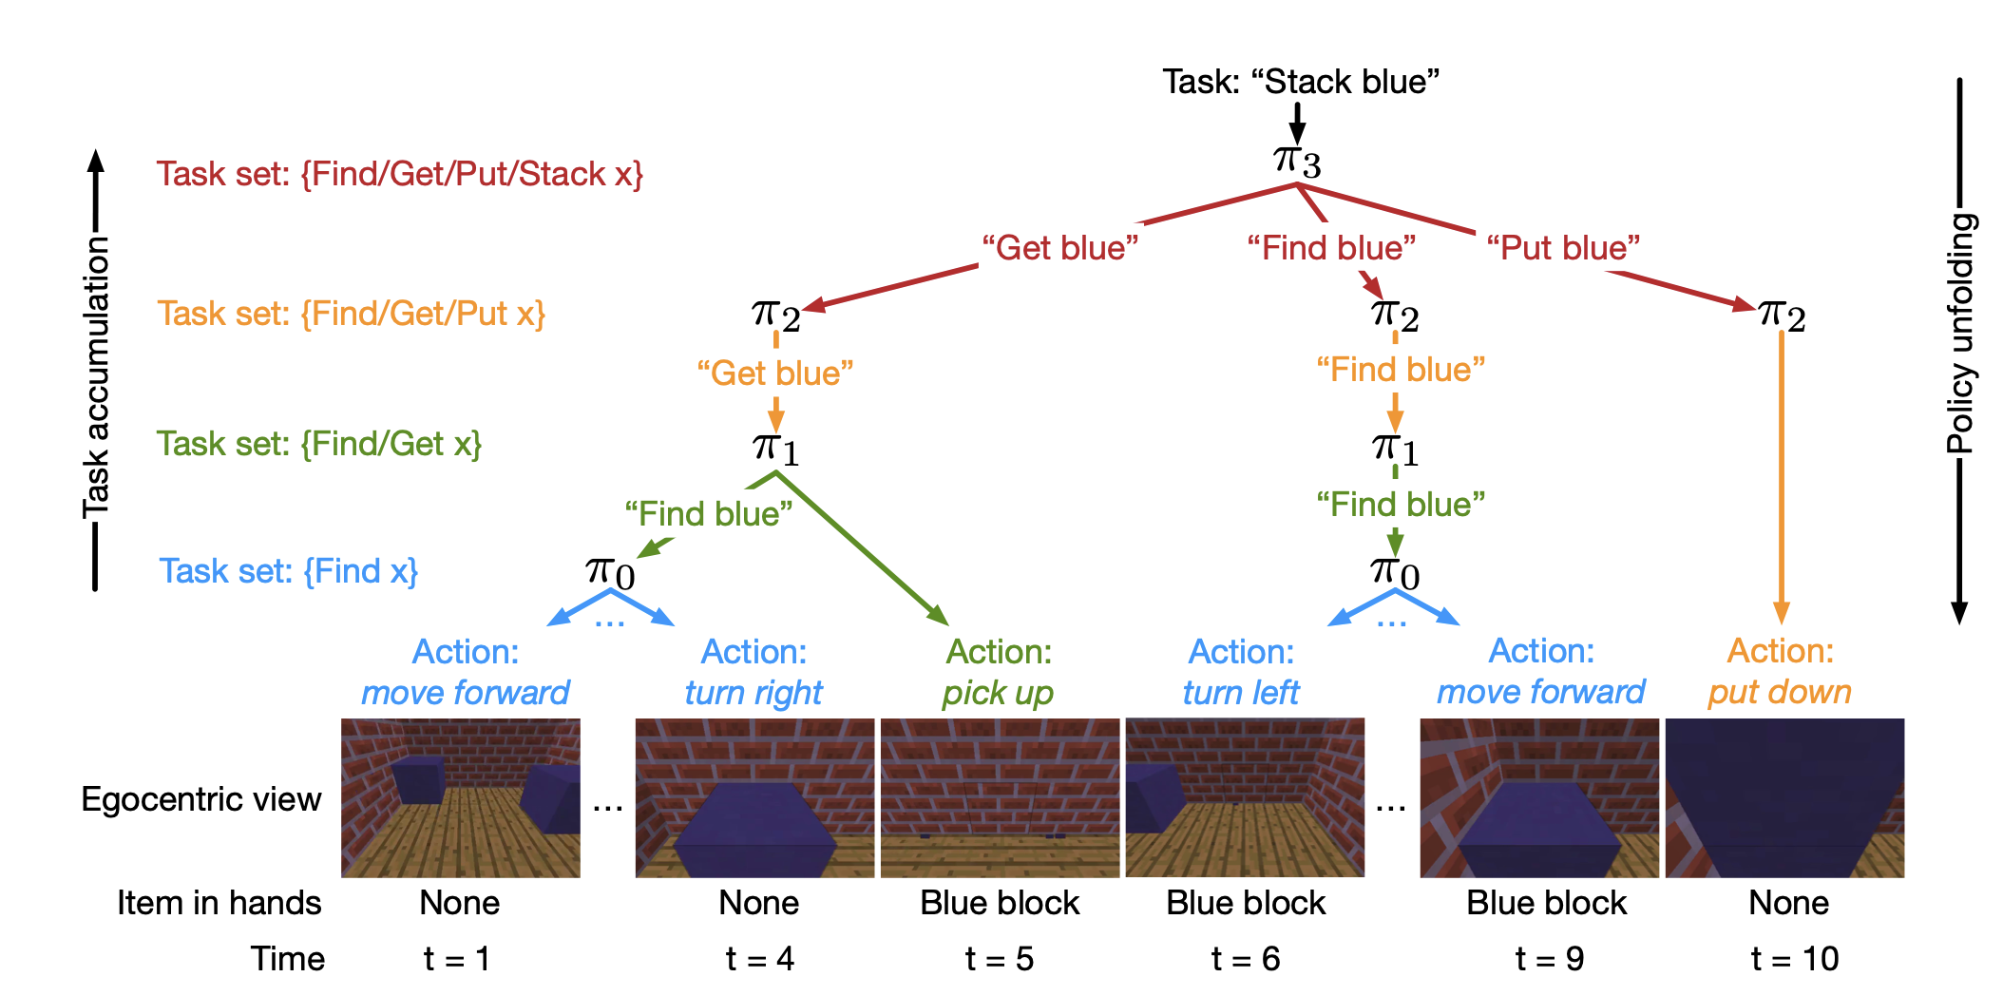
Hierarchical Policies
Hierarchical and Interpretable Skill Acquisition in Multi-task Reinforcement Learning by Shu et al.(2017)
  Complex task decomposed into several simpler subtasks.
  Each task is described by a human instruction (e.g. ‘stack blue’)
  Agents can only access learnt skills through these descriptions
Notes:
This slide illustrates how hierarchical reinforcement learning enables interpretable behavior.
The key idea is to decompose a complex task into simpler, reusable subtasks.
In this example, the high-level instruction is “stack blue.”
The top-level policy selects this task, but it does not act directly.
Instead, it invokes lower-level policies such as find blue, get blue, and put blue.
Each of these is itself a learned policy, not a single action.
As we move down the hierarchy, tasks become more concrete.
Lower levels correspond to simpler skills like navigating, picking up an object, or placing it.
At the bottom of the hierarchy, the agent executes primitive actions such as move forward, turn, pick up, and put down.
The left side of the figure shows task accumulation.
Each level builds on previously learned skills.
Higher-level tasks reuse and compose lower-level ones.
The right side shows policy unfolding over time.
A single high-level instruction expands into a sequence of sub-policies and actions.
The bottom row shows the agent’s actual observations and actions at each time step.
Interpretability comes from this structure.
We can explain behavior in terms of human-understandable instructions and subtasks.
Instead of asking “why did the agent take this action,” we can ask “which skill was it executing?”
CLOSING LINE: Hierarchical policies make RL interpretable by aligning decision-making with human task structure.

Slide 28
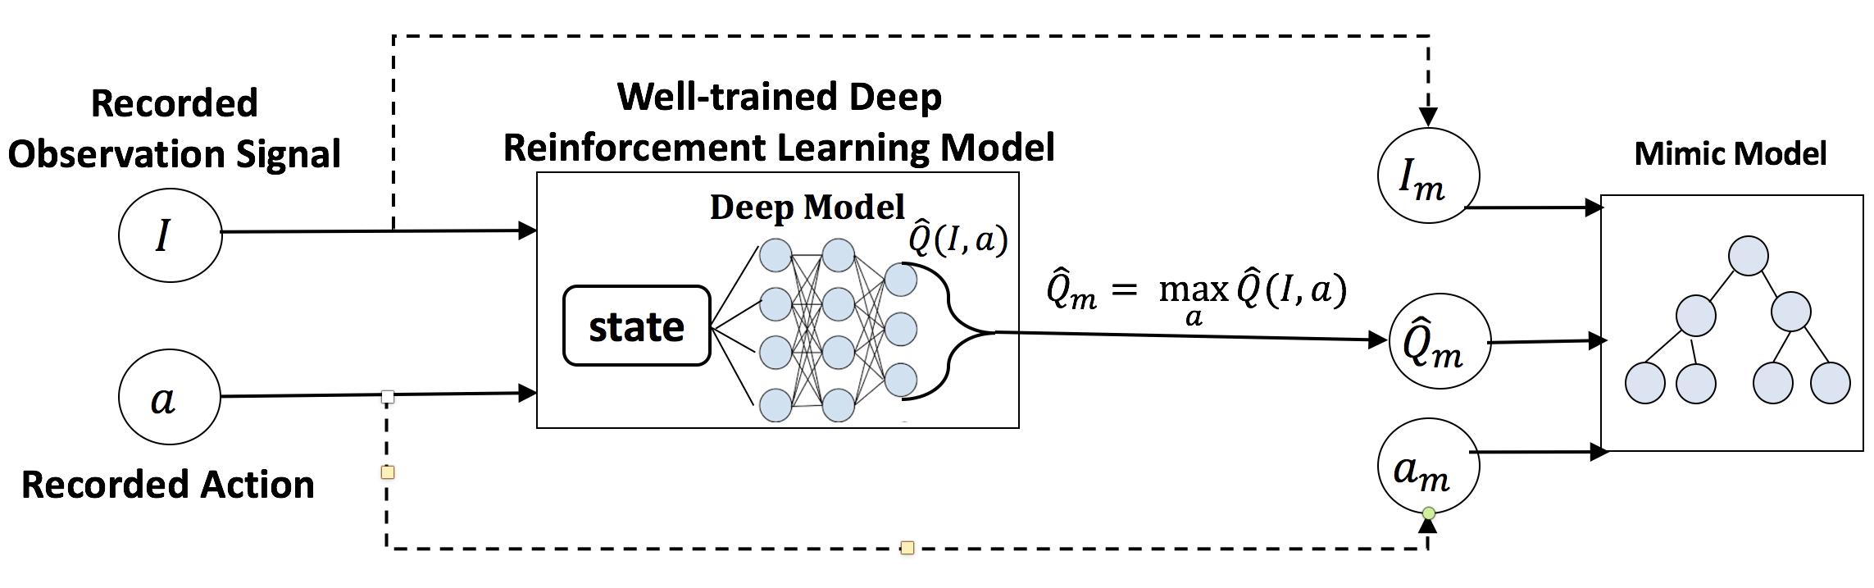
Linear Model U-Trees
Toward Interpretable Deep Reinforcement Learning with Linear Model U-Trees
by Liu et al.(2019)
  Approximates the predictions of an accurate, but complex model by mimicking the model’s Q-function
  Records the state-action pairs and the resulting Q-values as ‘soft supervision labels’
Notes:
This method focuses on explaining deep reinforcement learning models by approximating their Q-function.
We start with a well-trained, high-performing deep RL model.
This deep model is accurate but difficult to interpret.
As the agent interacts with the environment, we record state–action pairs.
For each pair, we also record the predicted Q-values from the deep model.
These Q-values act as soft supervision labels, not ground-truth rewards.
A Linear Model U-Tree is then trained to mimic the deep model’s Q-function.
The tree partitions the state space into interpretable regions.
Within each leaf of the tree, a simple linear model predicts Q-values.
The resulting model balances interpretability and expressiveness.
We can inspect the tree structure to see how the state space is divided.
We can inspect the linear models to understand how actions are valued locally.
The explanation reflects how the deep model behaves.
It does not explain the environment or the true reward function.
CLOSING LINE: Linear Model U-Trees explain deep RL by turning opaque value estimates into structured, inspectable models.

Slide 29
References
Miller, Tim. "Explanation in artificial intelligence: Insights from the social sciences." arXiv Preprint arXiv:1706.07269. (2017)
Breiman, Leo.“Random Forests.” Machine Learning 45 (1). Springer: 5-32 (2001)
Fisher, Aaron, Cynthia Rudin, and Francesca Dominici. “Model Class Reliance: Variable importance measures for any machine learning model class, from the ‘Rashomon’ perspective.” http://arxiv.org/abs/1801.01489 (2018)
Ribeiro, Marco Tulio, Sameer Singh, and Carlos Guestrin. "Why should I trust you?: Explaining the predictions of any classifier." Proceedings of the 22nd ACM SIGKDD international conference on knowledge discovery and data mining. ACM (2016)
Shapley, Lloyd S. "A value for n-person games." Contributions to the Theory of Games 2.28 (1953): 307-317
Lundberg, Scott M., and Su-In Lee. "A unified approach to interpreting model predictions." Advances in Neural Information Processing Systems. (2017)
Verma, A., Murali, V., Singh, R., Kohli, P., Chaudhuri, S.: Programmatically interpretable reinforcement learning. PMLR 80:5045-5054 (2018)
Shu, T., Xiong, C., and Socher, R. Hierarchical and interpretable skill acquisition in multi-task reinforcement learning. (2017)
Liu, G., Schulte, O., Zhu, W., Li, Q.: Toward interpretable deep reinforcement learning with linear model u-trees. In: Machine Learning and Knowledge Discovery in Databases, pp. 414–429. Springer International Publishing (2019)
Explainable Artificial Intelligence (XAI) DARPA-BAA-16-53 (https://www.darpa.mil/attachments/DARPA-BAA-16-53.pdf)

Slide 30
Thank You
As AI becomes more entangled into our daily lives, explainable AI becomes even more important.

